Slide 1
META Group Security and Risk Strategies
Global Security Update:
Trends, Strategies, Realities
Michael Warrilow
Senior Analyst
Security and Risk Strategies
michael.warrilow@metagroup.com

Slide 2
Agenda
Critical Issues
Introduction
Understanding key global trends in information security
Creating appropriate and reasonable information security
Technology
Organisation
Process

Slide 3

Delivering Return On Intelligence
Introduction
Founded 1989
Trusted advisor to 3,500+ enterprises globally:
  End-user organizations, Public sector, IT vendors
Core focus:
  Research advisory services
  Strategic consulting
  Benchmarking
Operate in 40+ countries
  250+ analysts, 300+ consultants
Issue 1
META Group delivers objective, actionable advice to help organisations leverage IT to meet business goals
Notes:
Delivering return on investment
Research, benchmarking, enterprise architecture – not product

Slide 4
Budget trends in information security
1. Key global trends
Business respondents indicated a nearly 50% greater security budget than did IT or Security respondents
CFO (38%) authorises security purchases nearly as often as CIO (42%)
Budget projections (%)
 | IT | Security
2003-2004 | - 0.5 | +4.4
2004-2005 | +2.4 | +4.3
Antivirus, firewall, IDS continue to dominate technology spending intentions
 | >100 users | 100-999 | 1,000-9,999 | 10,000+
2003 | 1.3 | 2.2 | 7.1 | 19.1
2005 | 1.9 | 3.0 | 8.6 | 20.7
Source: META Group

Slide 5
Spending intention
Anti-virus (at/near Internet gateway) for SMTP (email) traffic
Enterprise firewalls
Anti-virus (at Internet gateway) for HTTP (Web) traffic
Network intrusion detection
Personal/Node firewalls for remote access users
Vulnerability scanning
IPSec VPN (virtual private networks) for remote user connectivity
Host intrusion detection
User/Account provisioning and management (identity management)
Application-specific firewalls (e.g., for Web services or Voice over IP)
Certificate authorities/public key infrastructure (PKI)
Security event management console
IPSec VPN for remote office connectivity
SSL-based VPN for remote user connectivity
Personal/Node firewall for all users (including LAN-based)
Tokens for user authentication
SSL-based (clientless) VPN for extranet connections
IPSec VPN for extranet connections
Smart cards for user authentication
Source: META Group

Slide 6
Security Maturation
AWARENESS
PHASE
CORRECTIVE
PHASE
CONTINUOUS
IMPROVEMENT PHASE
<3%
Maturity / Value
Conclude Catch-Up
Projects
Continuous
Process Improvement
50+%
Design
Architecture
10%?
Track Technology and
Business Change
Develop New
Policy Set
Institute Processes
Review Status Quo
Initiate Strategic
Program
(Re-) Establish Security
Team
t
Source: META Group

Slide 7
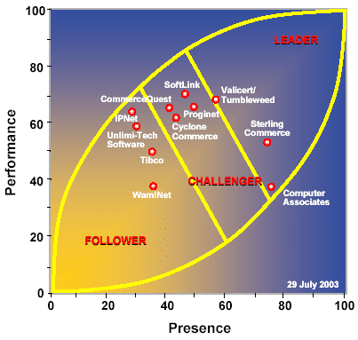
Market evaluation
METAspectrum: file transfer
METAspectrum
  Antivirus, enhanced file transfer
  Web Single Sign On
  Enterprise directory
  Enterprise firewall
Source: META Group
Notes:
The central theme of the METAspectrum methodology is that, to succeed in a market, vendors must combine market presence with performance.
a structured methodology
leverages evaluation criteria and subcriteria, tailored and weighted to the unique characteristics of a particular market
All vendors in AV METAspectrum have a proprietary antivirus scanning engine, a research lab, a full range of products that can scale for enterprise deployments, and substantial market share (i.e., >5%) among Global 2000 companies.
Almost all (95%) of our clients have desktop antivirus software and pay for annual maintenance, plus subscription renewals every two years. Although only 50%-65% of clients currently have e-mail protection, this number is rapidly rising.

Slide 8
Identity management - components
User life cycle
Identity Infrastructure
  Directory
  Single sign on (and administration)
    Web or comprehensive?
  User life cycle management
Breaking down the user provisioning process
  Creation, maintenance, deletion
Terminate
Promote
Access
Hire
Time
User life-cycle management and identity infrastructure are closely associated
Notes:
For details on ROI refer to slide 17 in this presentation
Case study from AusCERT 2003 report

Slide 9
Value of Identity Management
15% of IT staff involved with identity
User management consumes 5.25% of all IT productivity
Potential to improve productivity and efficiency
More than 30% users not deleted on departure
Technology
Balanced
Security
Organisation
Process
Notes:
We surveyed 420 large organizations. Results:
Automated password reset can save US$650,000/year in a 10,000 user organization
Potential to save 100+ hours per month
The average enterprise “size” was around 15,000 users (remember — average)
E-commerce actually happened. The average respondent had just shy of a quarter of a million external users to manage.
23% additional risk of breach where accounts not deleted

Slide 10
Stronger authentication
Tokens (mainstream)
Smart cards (rising)
  Major PC, PDA, phone providers begin to deliver smart card readers (2004+)
  Coupled with key management
    e.g. PKI, as deployments expand (2005/06)
  Challenges remain
    Cost, infrastructure availability, standards
Biometrics (niche)
  Limited deployment
  Impact of new border immigration measures?
    USA: Visitor and Immigrant Status Indication Technology (VISIT) system
Notes:
SRS Delta 2088: There are several reasons for lack of smart card adoption, including:
Cost:
Although prices for smart card read/write units are dropping to $15-$50 (US) for readers in large quantities, having infrastructure to actually use the smart card has remained elusive.
The cost of the smart cards themselves (approximately $1 US) tends to be 2x-5x the cost of alternative methods that perform similar functions (e.g., magstripe, 2-D symbology, or bar-code style cards). While the smart card is ultimately more flexible, the ability to achieve viable ROI lies in leveraging its multifunction capability, which takes more time
In addition to readers and cards, smart card management systems and middleware costs can be high, depending on the size of deployment and the degree and scope of integration required with the application environment.
Availability of infrastructure:
PC manufacturers have not been pressured significantly by smart card integrators or (more important) customers to add smart card readers as a standard part of the hardware platform.
Client operating system environments were not smart card reader “friendly” until Microsoft Windows 2000 was released, with Windows XP providing an optimum environment for smart card use - to date.
Of the card management systems available, current editions are focused on consumer-related smart card management and will require modification to be used routinely within enterprises.
Standards:
Although many of the critical hardware and software standards for smart cards have matured sufficiently (e.g., ISO/IEC 7816, Personal Computer/Smart Card, FIP 140-1 and 3, Java Card), standards work still remains in the following:
integration or “middleware” environment for smart card usage beyond basic network authentication (i.e., application authentication)
Integration with key and certificate-based systems, such as PKI, for a more comprehensive security solution
Integration for use in conjunction with biometrics
Development of multiapplication smartcards. While Java Card is widely accepted as the best platform for smart card use, the older MULTOS (Multiple Operating System) used in large commercial consumer deployments is still an option for enterprise use. Currently, JavaCard appears to be chosen more often for enterprise deployments.
Alternatives:
Simple USB-based systems from Alladin, tokens from RSA, and Datastrip’s bar-code symbology system could be used to deliver basic strong authentication services without the substantial investment in smart card infrastructure.
Short Message Service (SMS), used in conjunction with PIN numbers, is increasingly considered a viable alternative as well. These systems do not have the flexibility of a long-term multiapplication platform, but such long-term plans may not be important for many enterprises.
Common combination is
utilization of the smart card as a strong authentication tool for basic network authentication access,
coupled with physical building access use.
Excluding reader costs, a sample smart card system configuration performing similar functions as an equally equipped RSA SecurID system configuration is slightly less in list pricing and roughly equivalent in ongoing maintenance and operational costs.

Slide 11
New Requirements
Database: Relies on key management service
Application layer: Security is incomplete if applications are open
Common security services are the only cost-effective way to standardise application-layer security
Vulnerability management
Internal isolation / segmentation / compartmentalization
The rate of new technology introduction has not declined, and the rate of adoption by business has not either

Slide 12

And what about the firewall?
Firewalls get incremental function (2004/05)
Application security gateways take off
  Web, e-mail (now)
  Voice/data, Web services (2004/05)
Personal node defense systems
  For remote users (2004/05)
  For internal users (2004-07)
Notes:
Address the increasingly obvious shortcomings of currently deployed security controls as threats continue to evolve “up the computing stack”
Must incorporate application-layer controls in their security strategies as threats increasingly target vulnerabilities at that layer of the computing infrastructure.
Definition:
"gateway" implies more comprehensiveness in terms of security functionality
"shield" when primarily involved with making an access control decision for a single app based on content & protocol inspection
an ASG must apply security filtering and/or authorization services. a plain vanilla reverse proxy is NOT an ASG
Client Advisor: Application Security Gateways Take Form
With the increased complexity of networked applications and the corresponding exploitation of application vulnerabilities as an attack method, application level security tools are coming to the fore. We have introduced the term Application Security Gateway (ASG) to apply to those security products which sit in-line with critical traffic and provide deep application level inspection (often along with encryption, authorization, and other security services), most commonly with a proxy architecture. ASG offerings currently fall into one of four classes: for remote access, for transactional applications, for securing outbound internet connections, and for system to system (usually web services based) connections. Given their tight application linkages, ASG's are fundamentally different from traditional network tools such as stateful inspection firewalls and VPN devices, primarily because they solve the performance/functionality trade-off by having deep security filtering for a small set of applications rather than more generic filters for a broad set of applications.
BL: Application security gateways are not appropriate for every application, and network tools still have their place, but organizations should investigate ASG's as an additional layer of defense for their most critical applications.
hodge-podge approach to mail hygiene: separate vendors for spam, virus, content blocking, encryption, etc. goes away in favor of a single vendor approach
The email management market has not changed much in the past decade.
We believe several new market dynamics – increasing threats to system stability, classification of email as mission critical, increased attention to mail economics and the need for broad policy enforcement – will result in rapid vendor innovation and aggressive merger activity over the next several years
We believe these dynamics will cause organizations to increase their spending on mail management over the next several years
From about $22/user/year currently to 3 - 5 times
Check Point Next Generation, adopted the qualifier “with Application Intelligence” in lieu of the expected “feature pack 4” designation. The new moniker marks the combination of new and previously released application-centric features under the marketing message of a solution that delivers both network and application-layer security.
New gateway devices and appliances
SMTP, http appliance (Nokia, )
SSL based VPN … will it become secure web remote access gateway and/or something even larger?
Will app-specific gateway evolve to being Web Services gateway?
Personal firewalls
Personal firewalls are an essential security control for many remote access and telecommuting implementations, particularly when critical information is being stored on a remote computer (SRS 2065).
They can also be useful within the enterprise, helping to secure against internal threats and providing containment when an attack does occur.
Evolution will continue, fostering their reclassification as endpoint security systems.
By 2004/05, it will be common for products to include operating system shield capabilities - that is, the ability to control access at the system call level within the operating system.
By 2005, much as with antivirus software, personal/node security suites will be deemed by information security auditors to be a minimum requirement for all end-user stations.

Slide 13
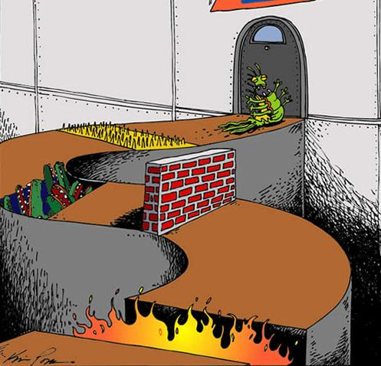
The perimeter is dead … or is it?
Increase in exploitation of application vulnerabilities as an attack method
  Need deeper application level inspection
Categories to consider
  Remote access
  Transactional applications
  Securing outbound internet connections
  System to system (e.g., Web Services, VoIP)
Notes:
Further research into app-level authorisation required. We recommend caution against hype at this early stage
Filtering will differ (transactional and integration usages v internal and remote access)
the emphasis of the security inspection is different
Application specific gateways could provide app level security in the form of filtering AND/OR authorisation

Slide 14
Trust management
Trust levels define specific risk mitigation and residual risk plans
Trust level definitions identify the appropriate business conditions to secure
Trust levels have an impact and cost
 | 0 | 1 | 2 | 3 | 4
Confidentiality |  |  | X
Integrity |  |  | X
Availability |  |  |  | X
Balance business desire for no security detail with technology delivery needs

Slide 15
Intrusion confusion
Isolation access control focus areas
  Application level inspection
  End point security / personal defence suite
    Incorporating AV, firewall, policy
Strong market demand for persistent, low management solutions that block, rather than “just” detect
  Proliferation of blocking techniques,
    Integration of management for network and host
  Plus other techniques
    traditional (AV) and new (Layer 7 monitoring)
?
Notes:
Blocking should only be enabled for positively identified misuse which turns out to be a relatively narrow (but very useful) band of detectable activity. Tuning difficulties have turned many IPS purchases into shelfware.

Slide 16
Security Management
Operational focus
  Separation of duties
Patch management
  High priority (thru 2004)
Security event management
  Mainstream adoption
  Enables cross-domain event consolidation, some correlation, and extensive reporting
Incremental user life-cycle management
  e.g., Integration with employee (HR) workflow

Slide 17
A Security Roadmap?
Rising interest in establishing formal security programs and architectures
  Anchored by trust-management techniques and well-defined strategic and operational processes
Next steps
  Governance and Program Management Services
  Identity Services
  Isolation Services
  Confidentiality and Integrity Services
  Detection and Response Services
  Applied Security Services
Notes:
Establishing a comprehensive information security solution requires organizations to keep an eye on the horizon, even as they struggle to deal with immediate and everyday challenges.
SRS Delta 1086:
Governance and Program Management Services
Regulatory and economic conditions will drive program formalization to be the most significant area of investment in information security during the next two years.
Having a definitive, documented, and defensible security program and architecture will be essential to limiting liability and protecting against wasteful and uncoordinated expenditures.
Development and enhancement of key security processes will dominate
Areas that will receive considerable attention in 2003/04 are
corporate program/process for security awareness and training;
policy/process for evaluating/certifying the security status of business partners and third-party providers to which computing connections will be made;
more rigorous and defensible process for conducting risk assessments;
program/process for ensuring secure systems development (i.e., ensuring security services are baked into application and system designs from the outset).
Identity Services
Most organizations have already embarked on projects to consolidate identity stores, to have identity and permissions functions be reusable infrastructure services, and to improve user-life management processes.
These efforts are substantial and will therefore be ongoing for at least two years, during which time they will continue to be among the top areas of security investments.
Increasingly, another component will be to establish tighter linkages to primary access methods and interfaces (e.g., portals), resulting in a blurring of identity and broader access management functions.
Interest in establishing stronger authentication mechanisms will remain steady, but significant activity will not occur until smart cards start to become widely accepted.
Isolation Services
For the next two years, we believe access-control-oriented measures will shift in two dimensions, focusing on application-level inspection (vs. just network level) and end-point security (vs. just perimeter controls).
Traditional firewalls will evolve and continue to play a role; however, they will increasingly be augmented by application-specific security gateways (see GNS Delta 1027).
In the near term, we believe maximum benefit will be derived from Web application shields (e.g., from KaVaDo, Sanctum), supplemented later by balanced investments in host intrusion detection and operating system shields (2004/05), which are also applicable to the shift to endpoint security.
They will be joined in that capacity by personal defense suites (i.e., firewall plus antivirus plus policy enforcement) to provide protection for end-user computing stations.
Initially focused on remote-user populations, such suites will mature during the next two years (driven by leading antivirus vendors) and then be deployed ubiquitously to also address the internal security threat. Other measures will also be taken to achieve internal security (e.g., additional segmentation, implementation of port-level authentication) as industry auditors shift their attention from the perimeter to the potentially more vulnerable internal network.
Confidentiality and Integrity Services
A primary manifestation of privacy concerns and legislation will be the increasing implementation of encryption technologies.
With transport encryption already well understood, investments in 2003/04 will focus on enterprise database and storage systems, as well as file/disk encryption for end-user systems (i.e., laptops, desktops, and PDAs).
We expect policy development and data classification processes to prove more challenging than implementing still-immature products.
Detection and Response Services
The preponderance of security breaches and associated costs continues to stem from exploitation of known, unpatched vulnerabilities.
As a result, establishing comprehensive patch-management solutions will be a top-five initiative during the next 18 months. Unlike past attempts, which have centered on vulnerability notification services, this will entail implementation of workflow components to cement the requisite process steps (including vulnerability notification, multilevel review and disposition, pre-testing, fix implementation, and fix confirmation).
2004/05 will be characterized by mainstream adoption of security event management systems, enabling cross-domain event consolidation, some degree of correlation, and extensive reporting.
Longer term, integrated, cross-device, configuration management consoles will be implemented and potentially linked to the former event management consoles to create a more closed-loop solution (2006/07). In the meantime, configuration integrity products (e.g., Tripwire) will remain popular as partial, single-device/domain solutions.
Applied Security Services
Applied security (i.e., security for individual business applications and specific types of client platforms, networks, and systems) will be deceptively significant throughout the next five years, primarily due to the shadow nature of investments in these areas (e.g., as part of major application projects).
Security for handheld devices, wireless networks, and messaging in the near term (2003) and collaborative applications, convergence, and Web services later (2004/05) will all be specific, somewhat-standalone areas of focus for organizations.

Slide 18
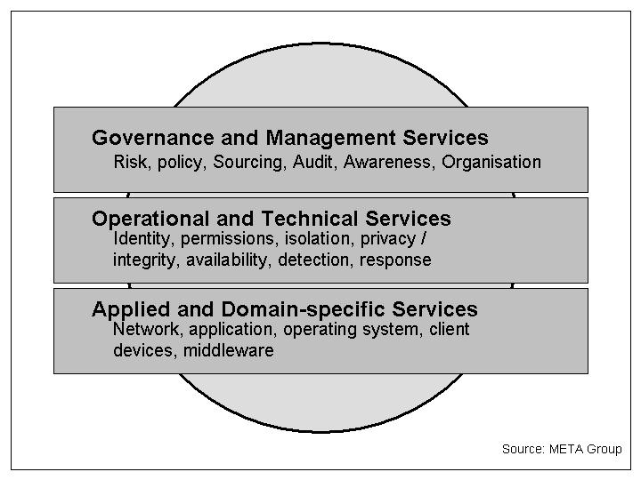
Determine role of security standards
2. Reasonable and appropriate security
META Information Security Framework
Legislation
  Cybercrime
  Privacy
  IT Governance
Global standards
  ISO 17799, ISO 13335, COBIT
META Information Security Framework (MISSF)
META Information Security Architecture (MISA)
Frameworks and standards continue to mature

Slide 19
Determine outputs
Governance
Admin Research
Monitor Forensics
Scan Response
Config Reporting
Annual Plan
Security
Operations
Process
Management
Foundation
Sourcing Architecture
Isolation Identity
Detection Privacy
App Svcs. Response
SPMO
Domains
and Trust
Marketing
Policy Mgmt. Role Def.
Classification Risk Assess
Domains Planning
Comm. Vendor Mgmt.
Trust
Strategic
Processes
Plan Build Run

Slide 20
Outsourcing security responsibility
Plan | Define enterprise charter | ●
 | Develop Architecture | ○
 | Develop Strategy | ○
 | Develop Processes | ○
 | Baseline Audit | 
 | Domain Definition | ●
Build | Develop Policies | ● 
 | Evaluate Products | ○
 | Systems Integration | 
Run | Management | ●
 | Info Resource Ownership | ●
 | Administration | ○
 | Operation & Configuration | 
 | Audit | 
 | Intrusion Detection | 
 | Response / Forensics | 
Keep inhouse | ●
In or outsource | ○
Outsource | 

Slide 21
Security is complex, so …
Bottom Line
Start at the beginning
  Define the strategy for a security program
Manage the budget
  Define business case and ROI for initiatives
Communicate as you go
  Include awareness training in the plan
  Demonstrate incremental value per quarter
Be pragmatic
  Create a cycle of continuous improvement … not ‘fix stop’ or ‘break fix’
  Don’t try and boil the ocean

